Slide 1
Lending Club Case Study SUBMISSION
Group members:
Siddakka Saptasagare
Kumaraguru Muthuraj

Slide 2
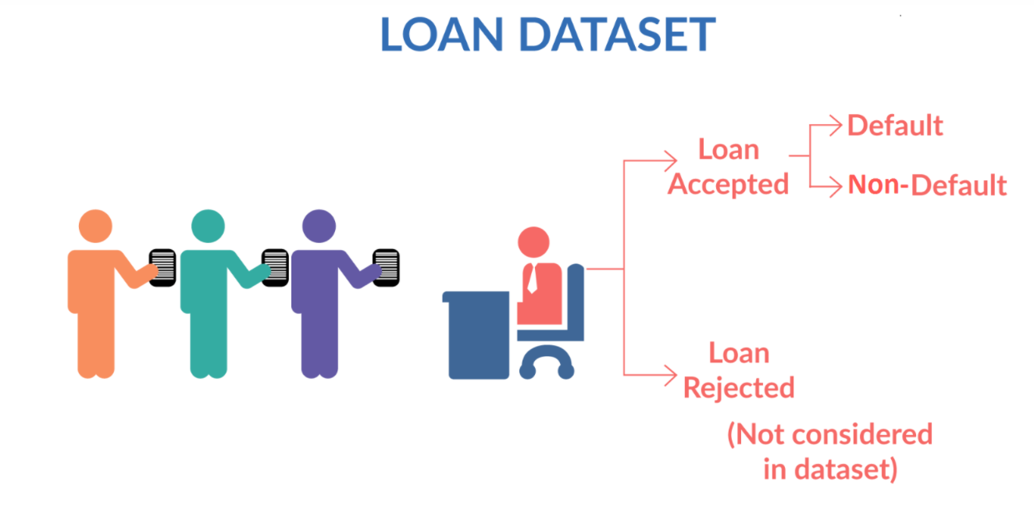
Objective of the case Study
When applicants apply for the loan there will be 2 possible cases:
Loan Accepted
Loan Rejected
When Loan is accepted it has 3 possible results as below:
Fully Paid: applicant pays the full loan amount
Current: applicant is still paying the EMI
Charged off : applicant has not paid the loan for some period of time. He/She may become defaulter
When the loan defaults, it will cause great loss to the lending company.
Identifying the risky loan applicants and the driving factors for the loan default will benefit the company.

Slide 3
Analysis and Problem Solving process
Understanding the Business Objective
Loading the input data set
Cleaning and standardizing the data
Exploratory data analysis
- Load the data file
- Extract and read the csv
- Drop unused columns
- Convert data type to correct format
- Perform univariate analysis
- Check the distribution and frequency of data
- Create derived columns to ease the analysis process
- Perform bivariate analysis
- Check the impact of variable on loan status
- Check the correlation b/w numeric variables
- Filter the data as per highest significant factor
- Perform multi-variate analysis
- Plot different graphs to visualize the results
- Summarize the result
- Conclusion about the loan risk factor

Slide 4
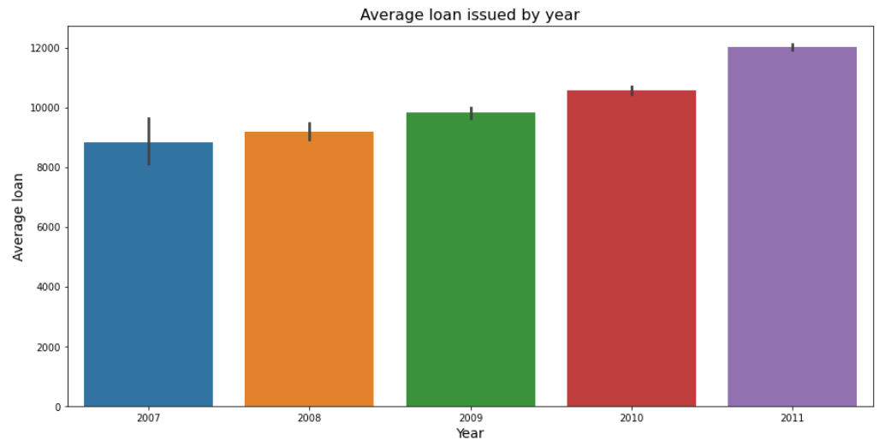
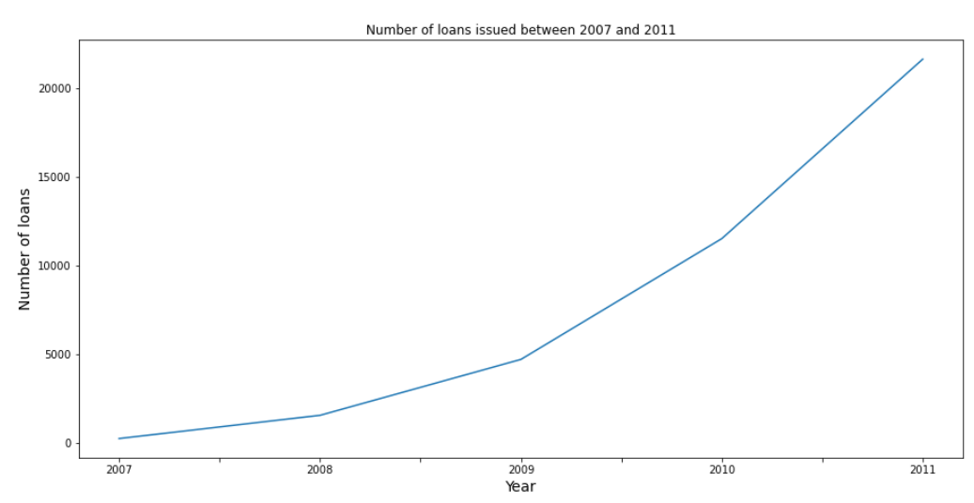
Analysis of Loan amount issued
As shown in the below graphs the loan amount issued varies from 5000 to 20000
Amount of loan issued and no. of loans are increasing over the years from 2007-2011

Slide 5
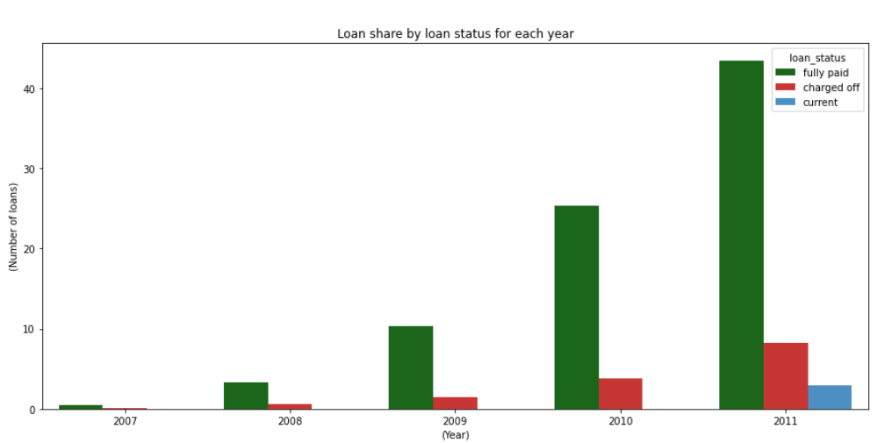
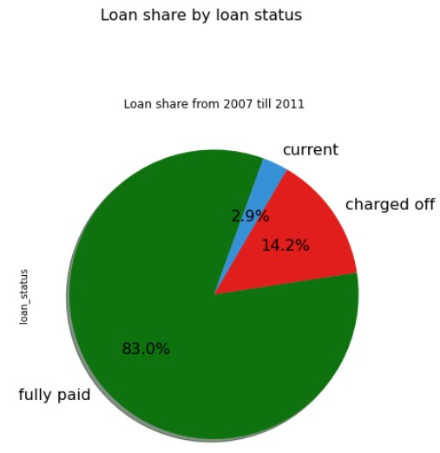
Analysis of loan status of total loans issued across years
As shown in the below graphs the total 14.2% loans are charged off
No. of charged off loans are increasing over the years

Slide 6
Identifying different factors for default loans
Analysis done by filtering data of year 2011
Loan status vs Grade analysis
Loan status vs Loan amount and interest rate analysis
Loan status vs income, loan to income ratio
Loan status vs Purpose of the loan
Loan status vs different regions
Loan status vs Home ownership
2. Analysis done by filtering the data of only charged off loan status
Loan status vs Loan term and Interest rate
Loan status across top 4 states, top 4 purpose and top 4 month
Loan status vs top 4 purposes and Loan Issue month
Loan status vs Annual income criteria
Loan status vs Employment length
Loan status vs home ownership and verification status
Loan status vs home ownership and DTI

Slide 7
Analysis done by filtering data of year 2011

Slide 8
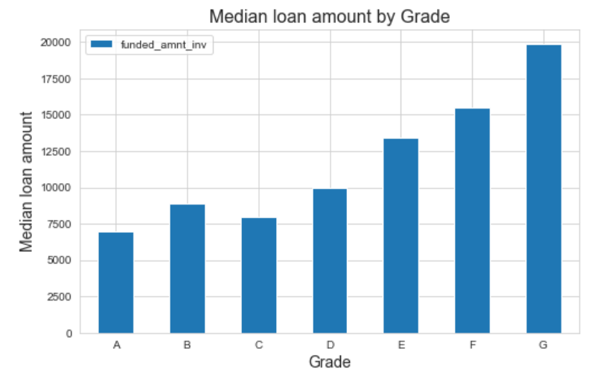
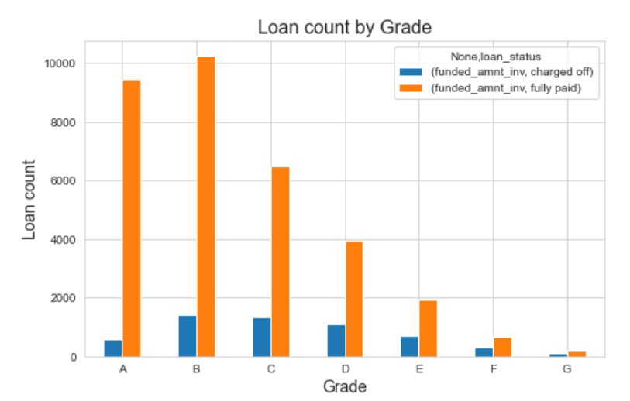
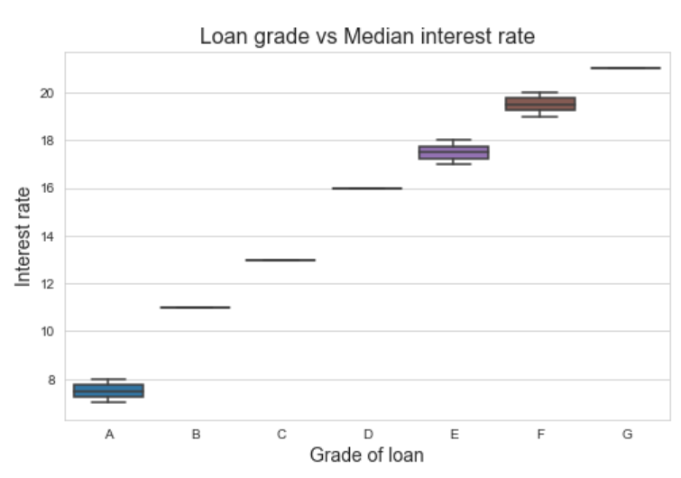
Loan status vs grade analysis
Risk 1 - Loan grades E, F and G are higher risk loans. Looks like LC is already charging higher interest rate to recover faster. When LC issues a high loan amount they have to look at other risk factors listed further.
Risk 2 - Most of the loans above interest rate 15% are at the risk of being charged-off. Higher the interest rate they might be charged-off.
Risk 3 - Looks like charged-off loans are from a slightly higher loan amount in the order of 12K and higher. Higher the loan amount its more risky.

Slide 9
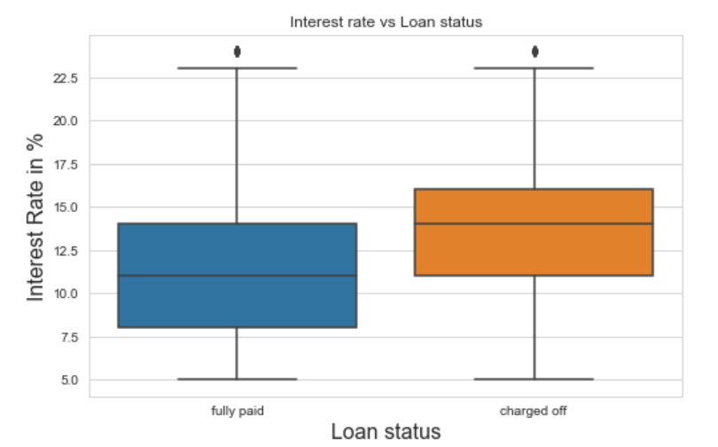
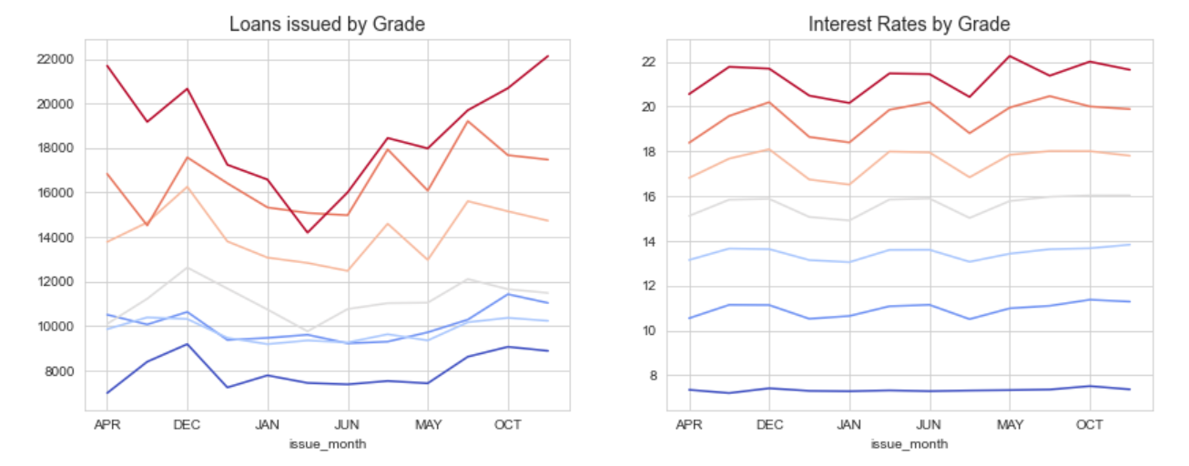
Loan status vs Interest rate analysis
As shown in the below plot, fully paid loans have interest rate <12.5% and are good loans
Loans having interest rate >12.5% are charged off and have the risk of becoming bad loans
Lending club should give the loans with interest rate <12.5% to reduce the loss

Slide 10
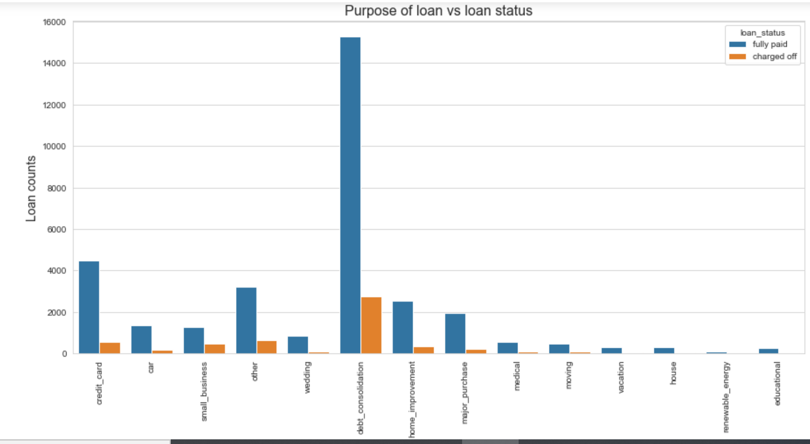
Loan status vs Loan purpose analysis
Debt consolidation, credit card, small business, other and home improvement reasons have highest charged off debts.

Slide 11
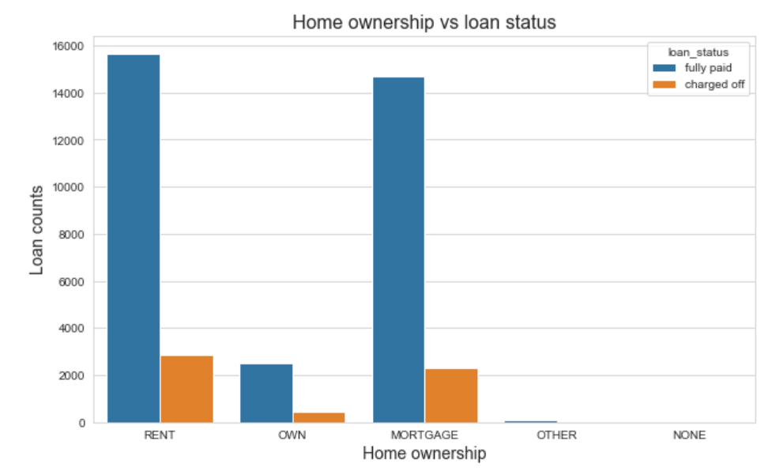
Loan status vs Home Ownership Analysis
Rental and Mortgage home dwellers have higher charged-off status than owners. A customer from rental home is risky, followed by mortgagers.

Slide 12
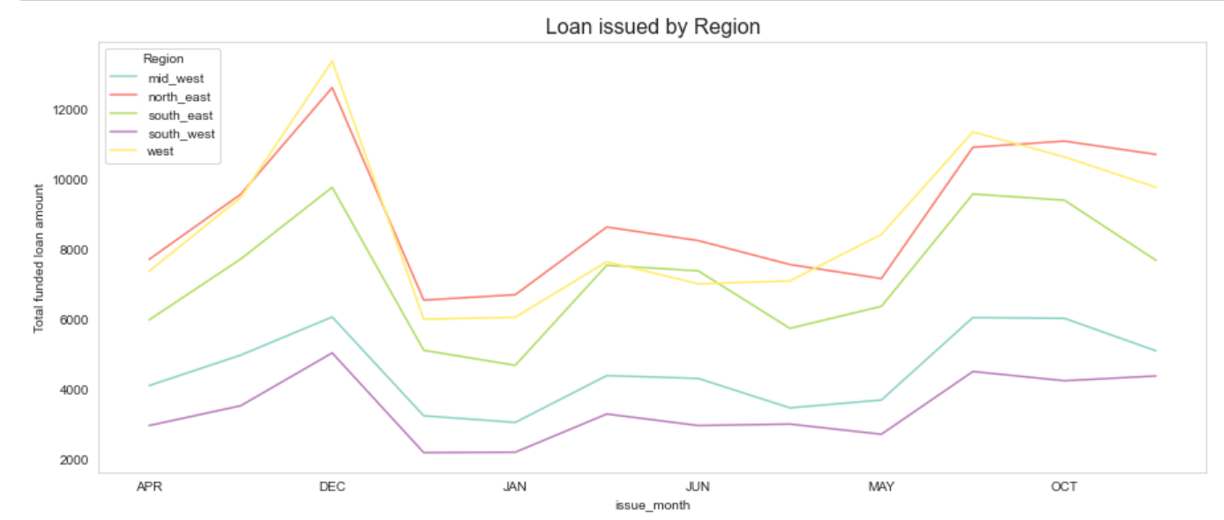
Loan status vs region analysis
States grouped based on geography, indicate West region has taken more loans. A loan request from western states is risky, especially California.

Slide 13
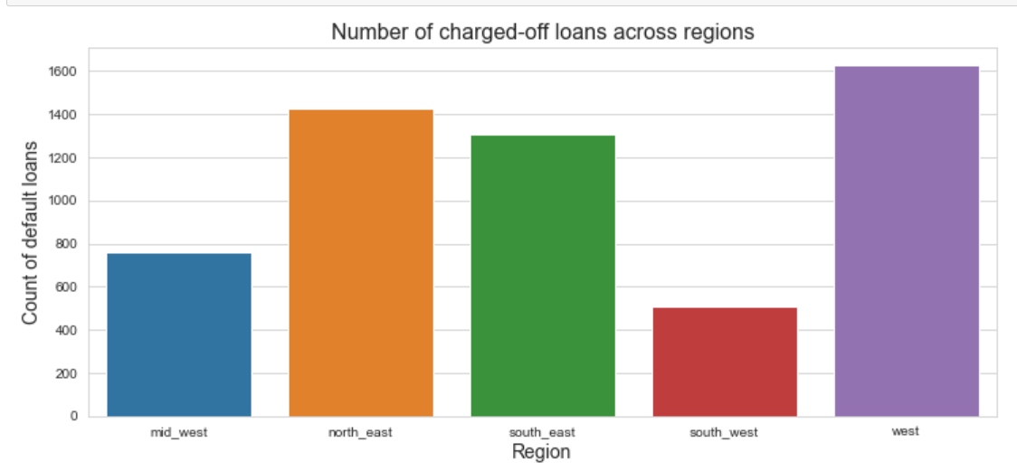
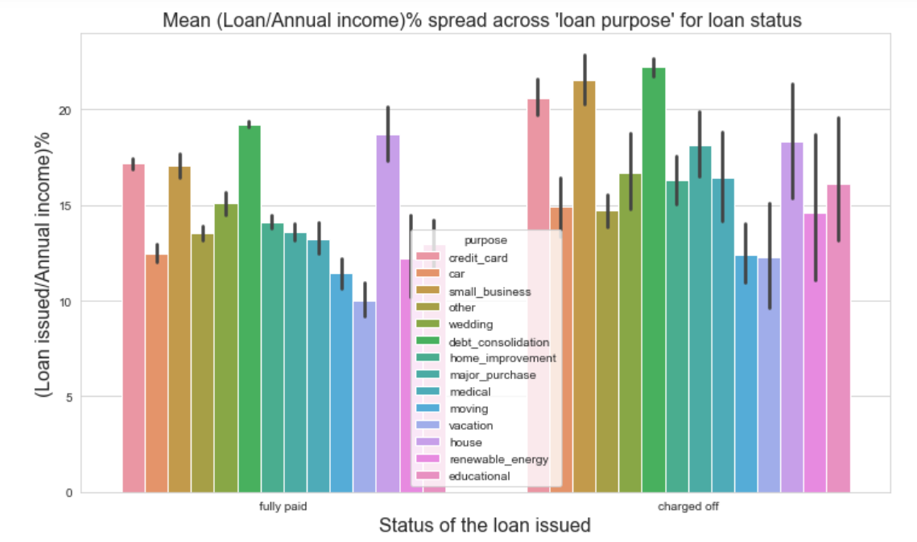
Continued…
Maximum Loans issued in the region of west are being charged off
West has the lowest loan to income ratio

Slide 14
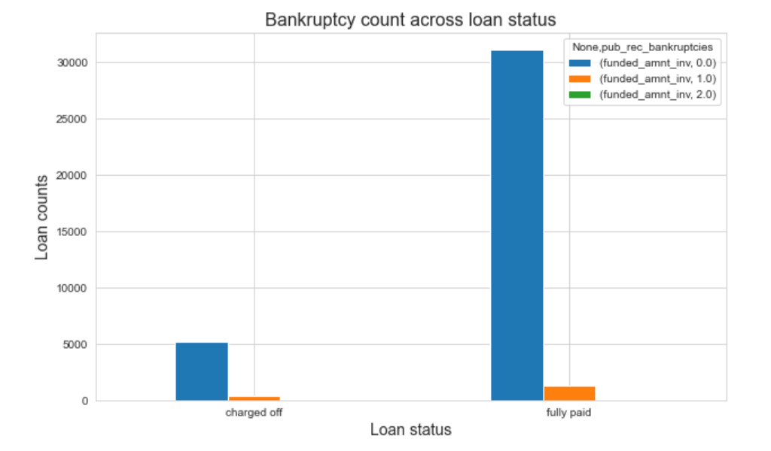
Loan status vs public bankruptcies
As the loan amount increases no. of bankruptcies declared also increases
Loan borrowers who have declared bankruptcies 1-2 times are more prone to becoming defaulters. Hence Lending company should avoid approving loans to such borrowers

Slide 15
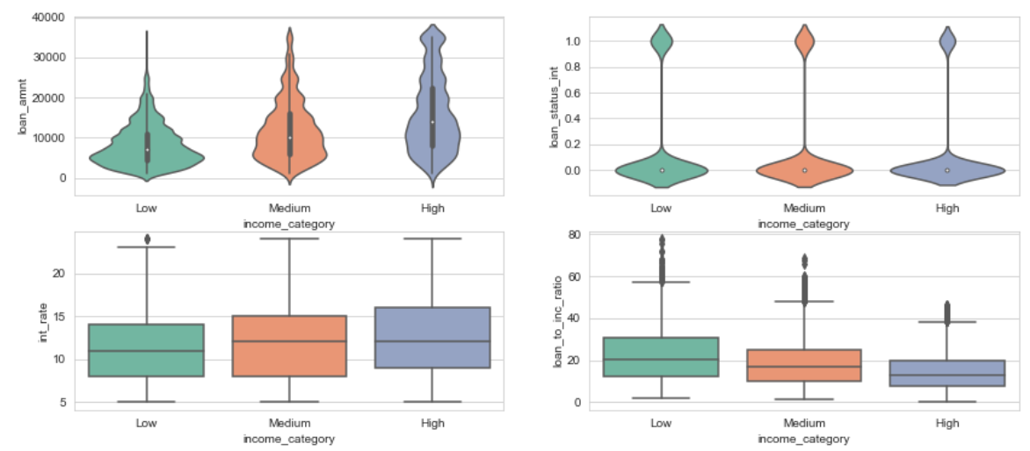
Loan status vs public bankruptcies
Loans of the high income category took higher loan amounts than people from low and medium income categories
Loans of the Low income category had a slightly higher chances of becoming a bad loan.
Loans of high income had on average higher interest rates
Loan of low income had average higher loan to income ratio

Slide 16
Analysis of charged off loans across top-4 factors

Slide 17
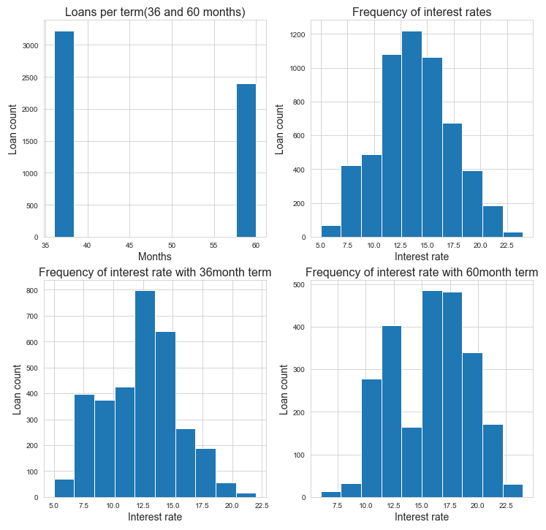
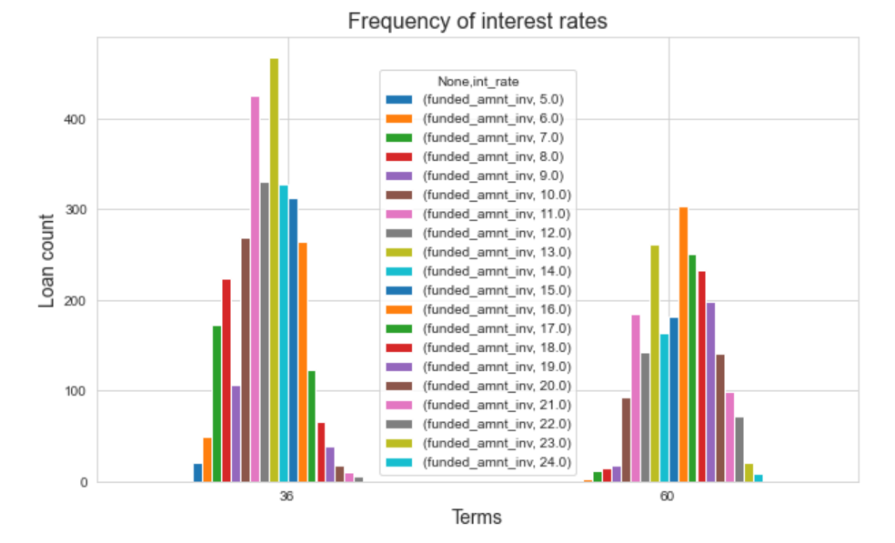
Loan status vs Loan term and Interest rate
For both 30 and 60 month loan terms, if the interest rate is reduced, defaulting behavior can be reduced

Slide 18
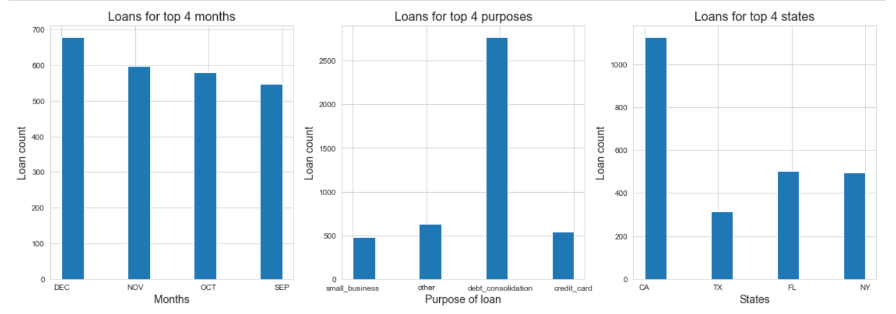
Loan status across top 4 states, top 4 purpose and top 4 month
The top 4 states are 'CA', 'FL', 'NY', 'TX’.
Top 4 purpose for which loan is issued are 'debt_consolidation', 'other', 'credit_card', 'small_business’.
op 4 months when loan issued are defaulted - 'DEC', 'NOV', 'OCT', 'SEP'.

Slide 19
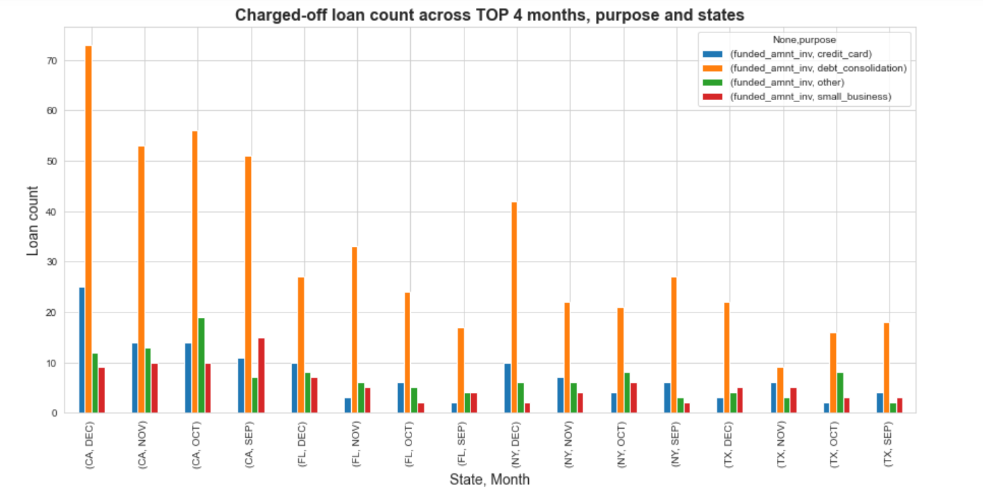
Loan status vs top 4 purposes and Loan Issue month
Issuing loans in Sep-Dec (specifically Nov and Dec), for the 4 states with debt consolidation as purpose is risky
Customers ask for loan with debt consolidation as a reason in the 4 (especially California) states and default maximum
Towards the end of the year, as celebration begins, customers prepare to take the loan and spend-off and default

Slide 20
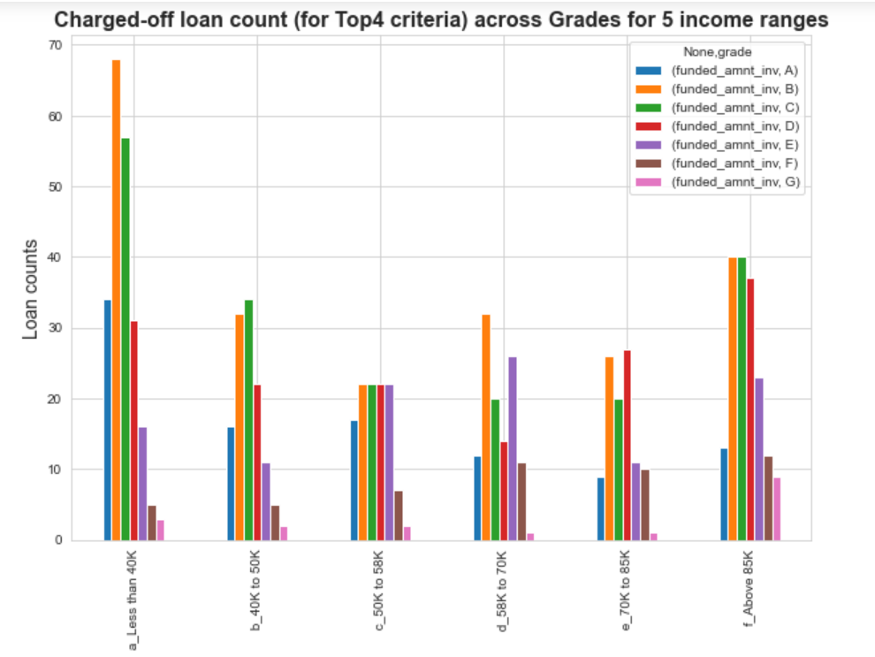
Loan status vs Annual income criteria
Approving loans with 40K loan amount rage for grade C, B and A is risky

Slide 21
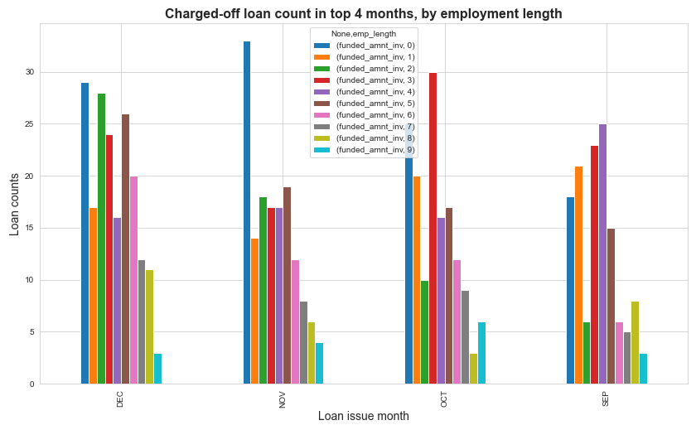
Loan status vs Employment length
Approving loans with in the month of Nov and Dec with employment length less then 2 years is risky

Slide 22
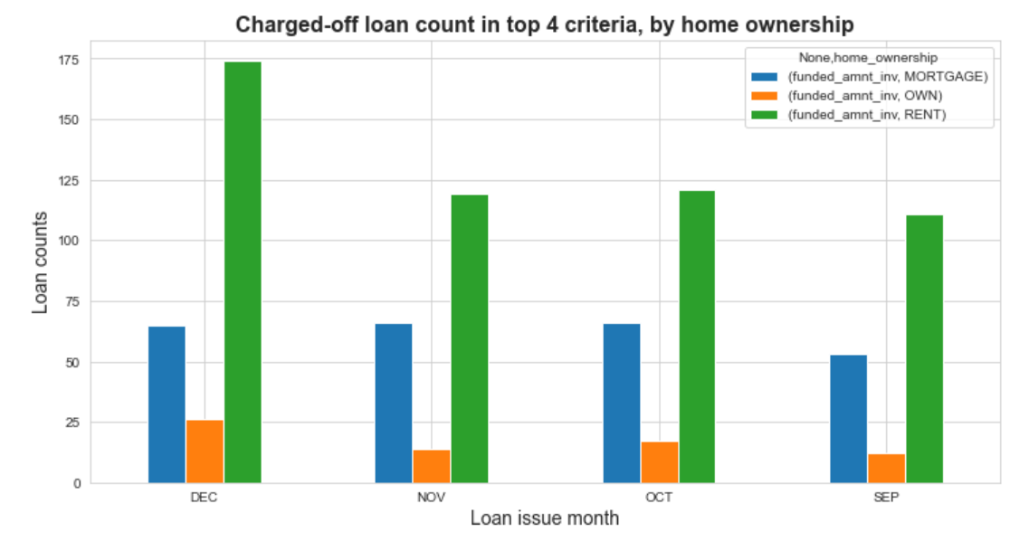
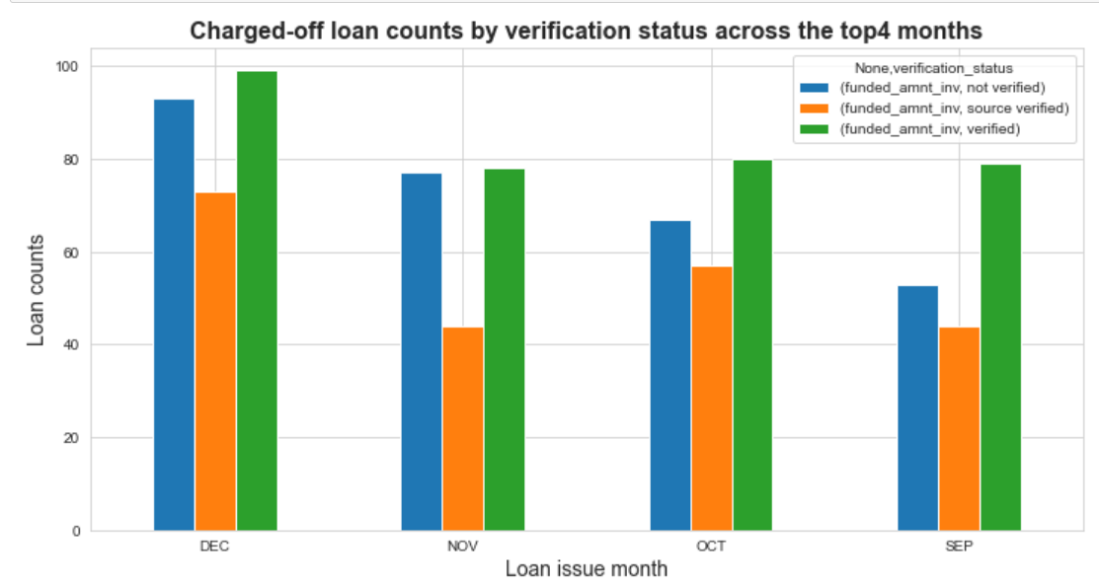
Loan status vs home ownership and verification status
Approving loans with in the month of Nov and Dec having rented homes for the top-4 purpose is risky
Approving loans at the end of year for top-4 purpose without verifying the source is a risky

Slide 23
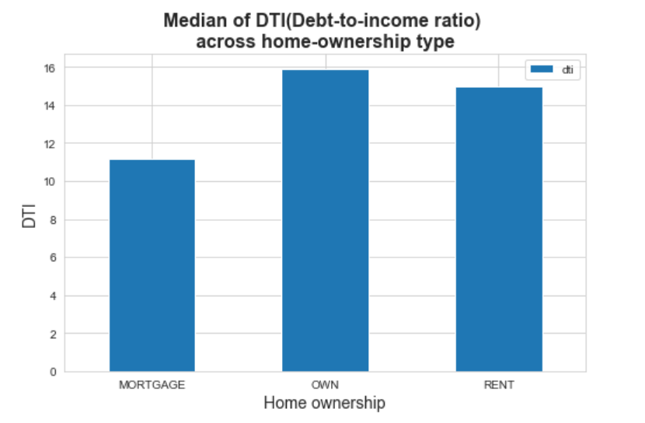
Loan status vs home ownership and DTI
Approving loans for the borrowers with rented home and mortgage is risky
Rent and mortgage borrowers have high debt to income ration. Hence Lending club should verify the borrowers profile before approving the loans

Slide 24
Conclusion of the Lending club loan dataset analysis
From this EDA analysis of Lending Club, we conclude that many factors, like the month of issue of loan, state where it was issued, purpose of loan are directly linked to defaulting tendency.
Many other factors like employment length, DTI, income verification, funded loan amount, interest of loan influence the loan defaulting nature.
Whenever LC receives an application they can derive at a risk score as a factor of all the above parameters by assigning a weightage to them.
Consider LC tightly controls loan applications with the following overlapping conditions:
Customers with less than 2 years of experience
Loan grade is A, B or C
Purpose of loan is debt consolidation, other, credit card, small business
Rental customers
Income is less than 58K.
LC could have converted 2916 charged-off loans worth USD20,038,752 to good loans (of the total 5627 charged-off loans worth USD61,131,728) which is 32%

Slide 25
Thank YOU

